Slide 1
Samsung
Innovation
Campus
Artificial Intelligence Course

Slide 2




Meet the Team
Ahmed Elsayed
Omnia Saeed
Mira Ehab

Slide 3

Personal Key Indicators of Heart Disease
Supervised By: Dr. Doaa Mahmoud
Supervised By: Eng. Mohamed Abdullah

Slide 4

Agenda
Introduction to Data.
Objectives.
Data Analysis.
Data Preprocessing.
Modeling.
Business Solution and Recommendations.

Slide 5

Problem
Definition
About Dataset
2020 annual CDC survey data of 400k adults related to their health status
Key Factors
1. high blood pressure
2. high cholesterol
3. smoking
4. diabetic status
5. obesity (high BMI) 6. physical activity
7. drinking alcohol
What topic does the dataset cover?
heart disease is one of the leading causes of death for people in the US
About half of all Americans (47%) have at least 1 of 3 key risk factors for heart disease

Slide 6
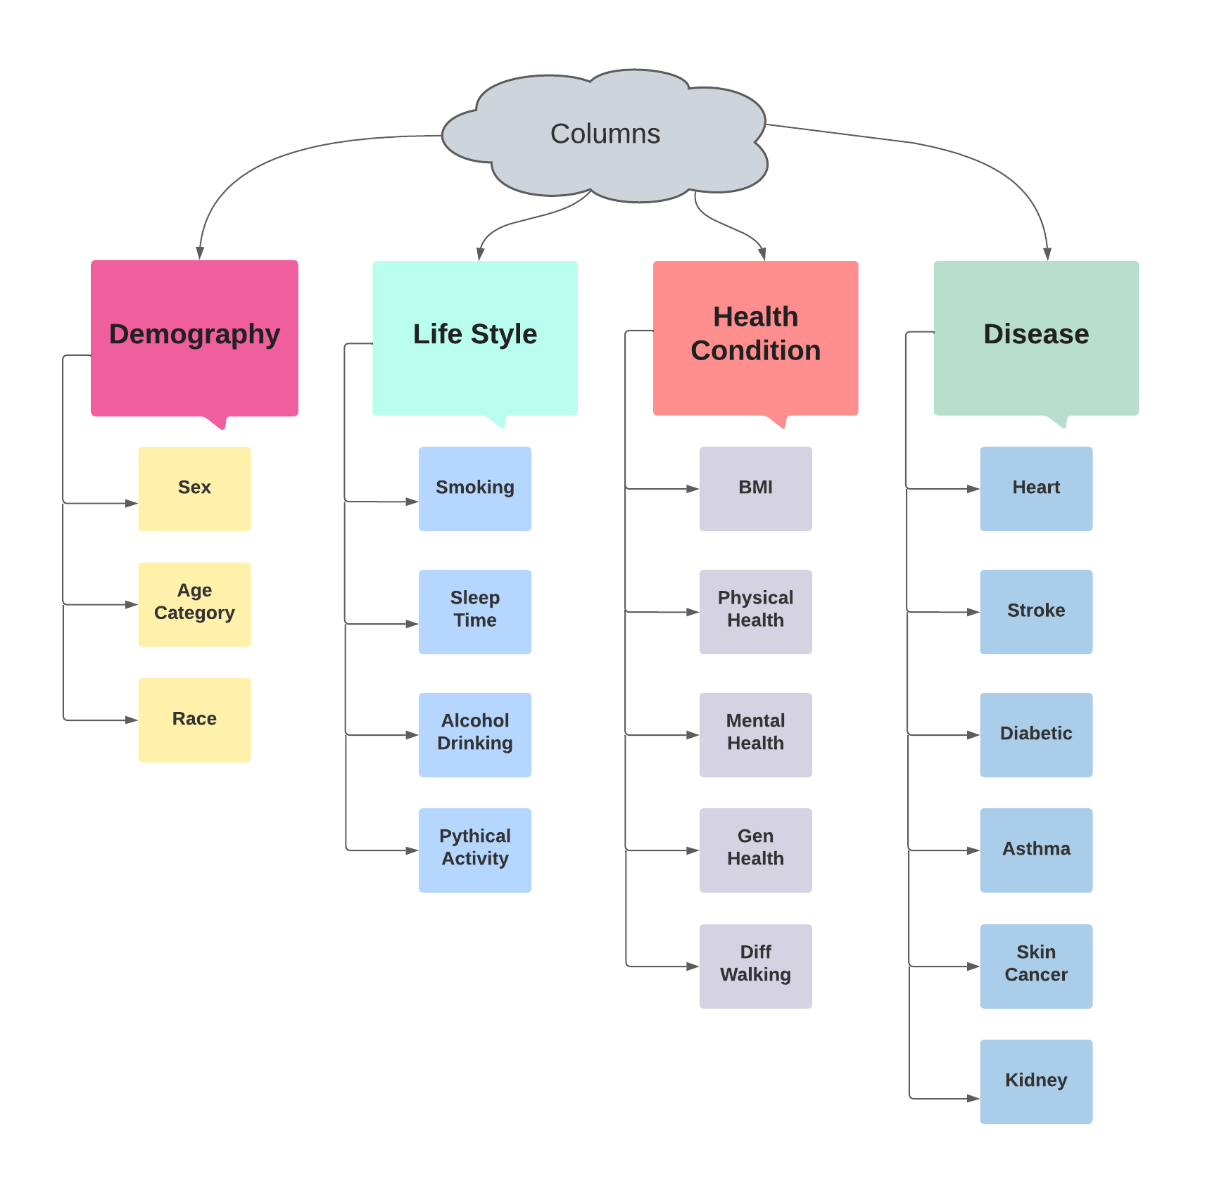

Data
Descripti n

Slide 7





Objectives
Find Why People were Dying due to Heart Attacks
Show the side effects of Heart Diseases
Try to predict the Heart attack before it's too late
Give some advice for people to prevent themselves from getting a Heart Attack

Slide 8
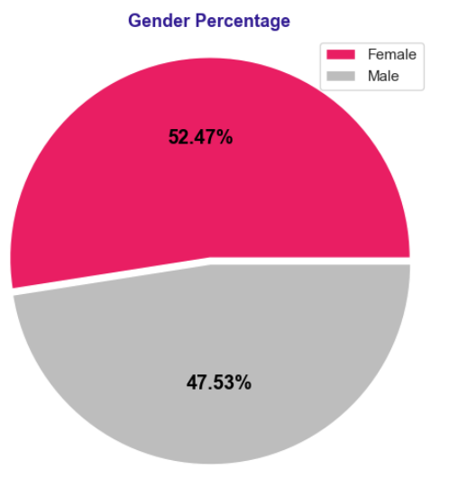
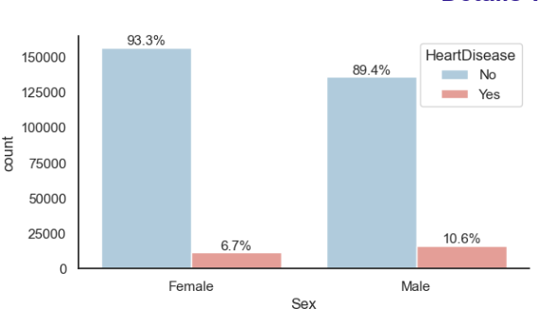
Data Analysis
Analysis Based on Gender
Q. What is the percentage of effected people by Heart Disease based on gender
As we see most effected people were Males

Slide 9
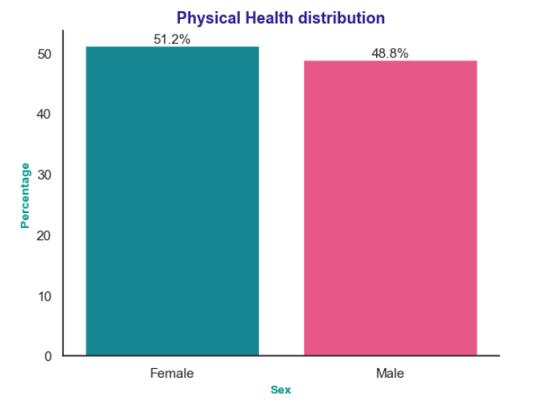
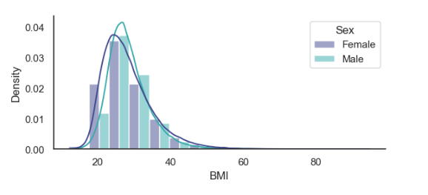
Q. Who were Care about its health Males or Females?
Average BMI for Males is greater
Its now obvious why Average BMI for Males is greater

Slide 10
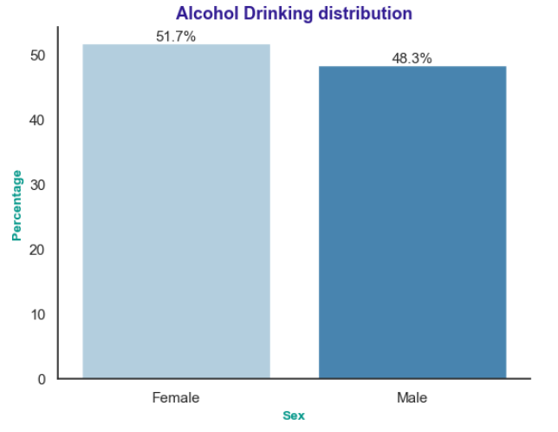
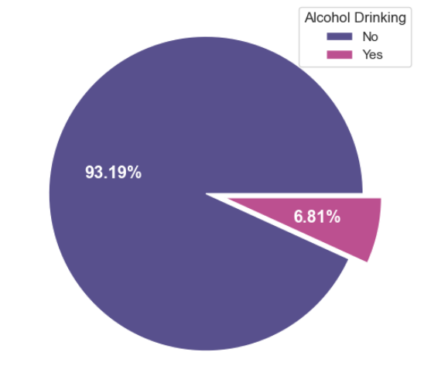
Does this mean Females are not drinking Alcohol less than Males ?
Females take the lead also and achieve the highest percentage in drinking alcohol!

Slide 11
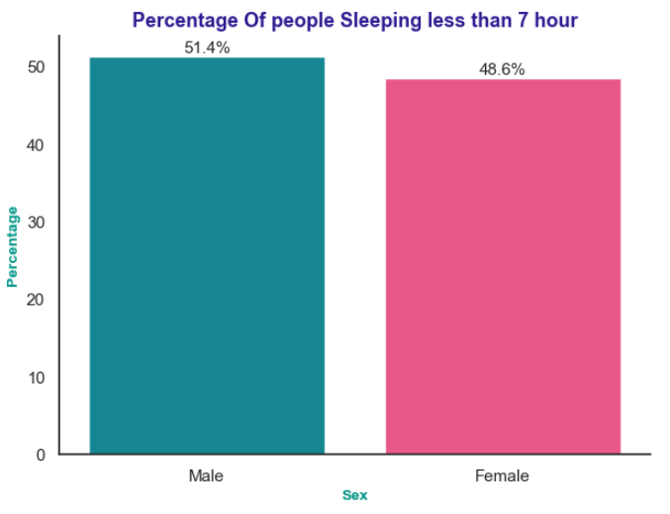
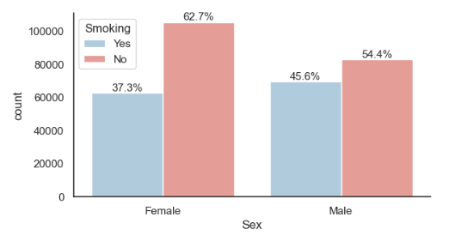
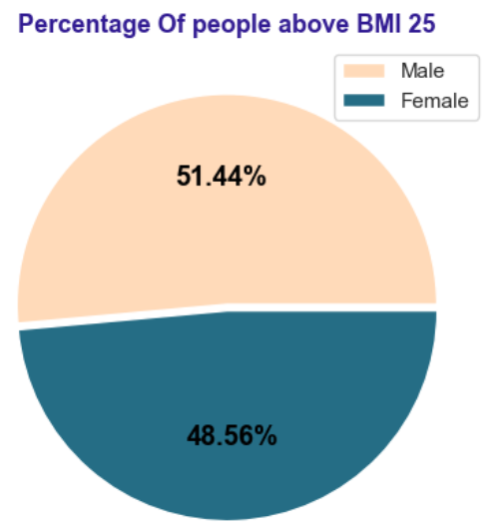
Q. What are the Key Factors to get Heart Diseases
Males are recorded the highest percentage of affected by heart attacks due to obesity and Smoking

Slide 12
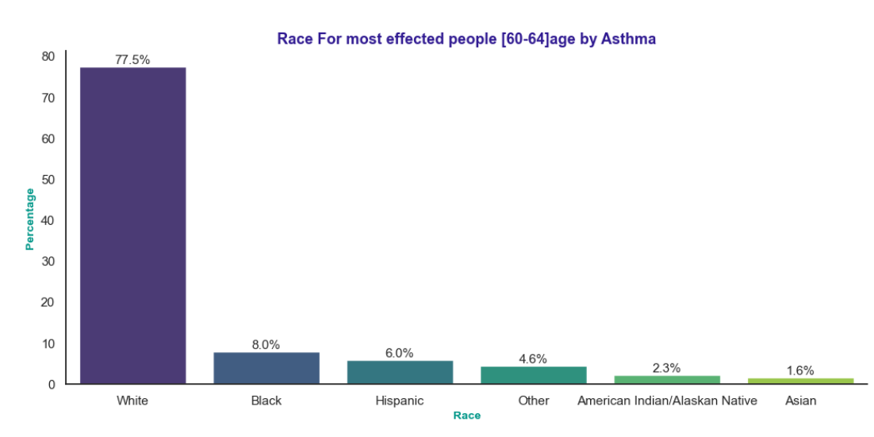
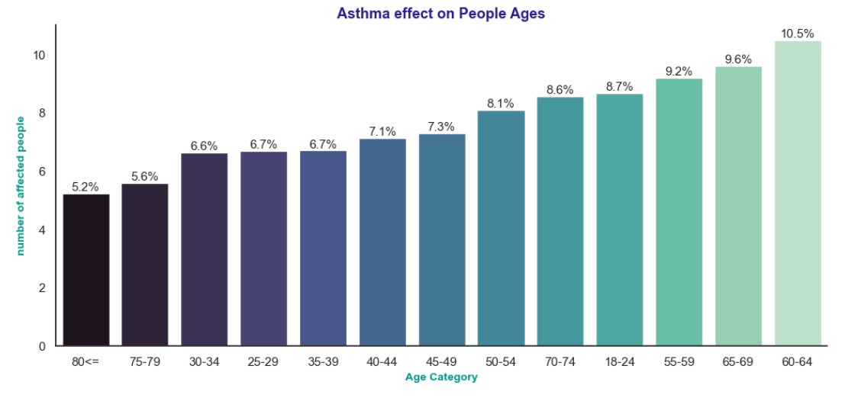
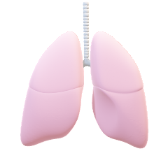
Asthma
Overview
Asthma is a condition in which your airways narrow and swell and may produce extra mucus.
This can make breathing difficult and trigger coughing
Q. Who is the most affected age category and its Race

Slide 13

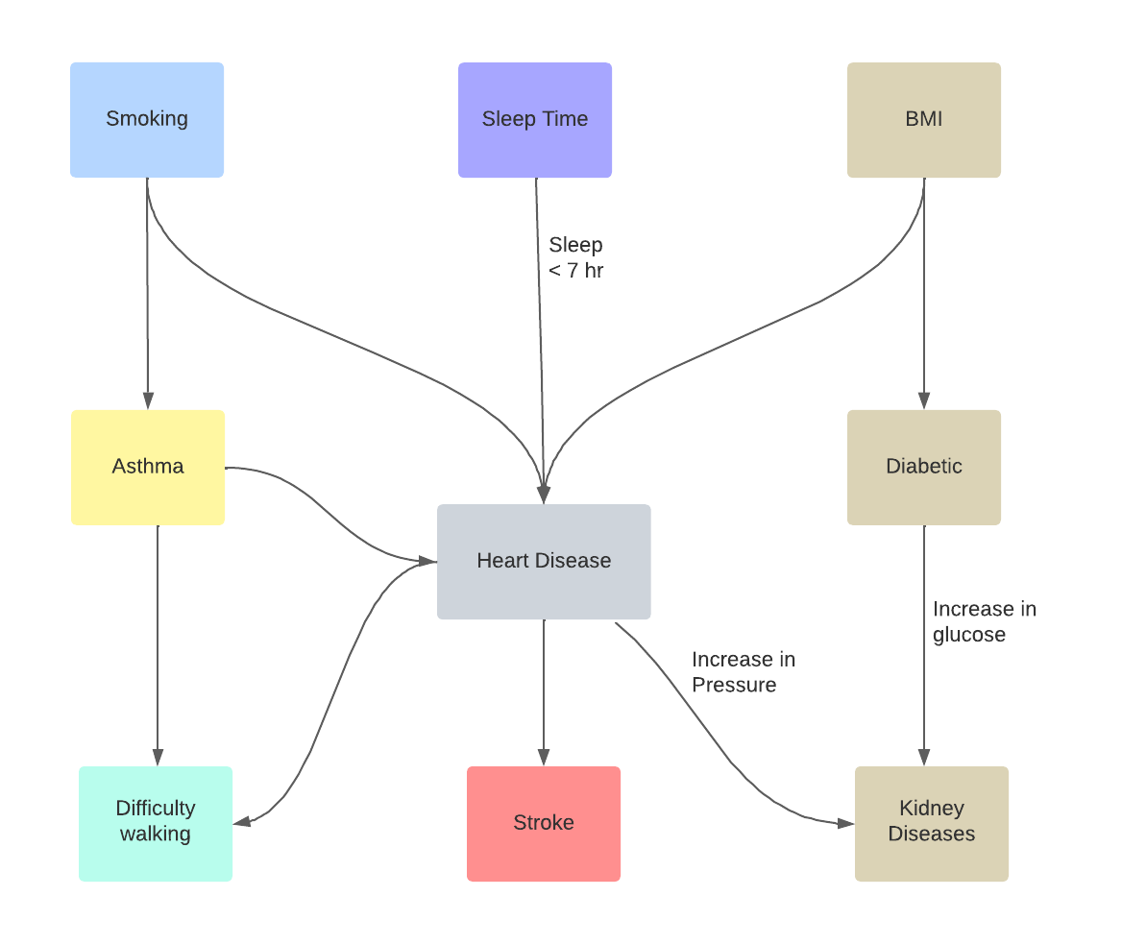

Slide 14
Data Preprocessing
Checking for null values
Checking for outliers
Checking for imbalanced data (Data standardization)

Slide 15
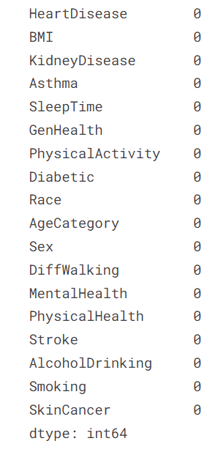
Checking for null values
Data is clean, there are no null values

Slide 16
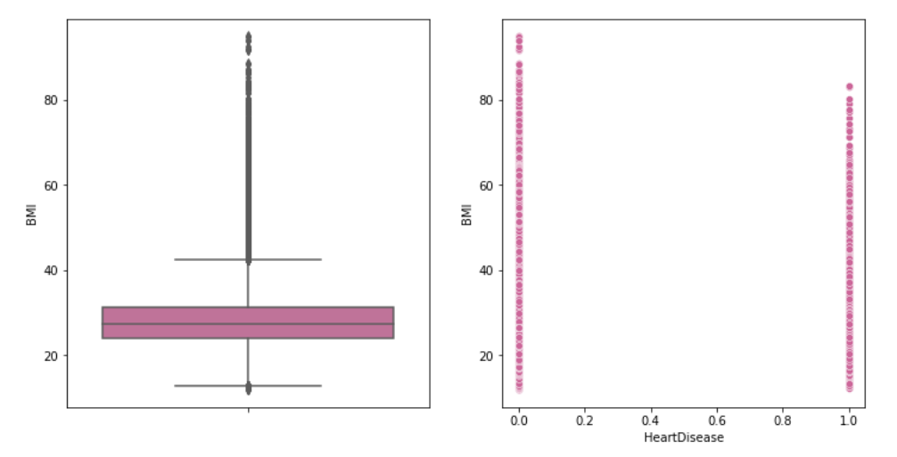
Checking for outliers
Outliers in BMI feature

Slide 17
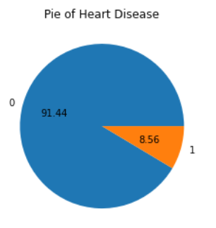
Checking for imbalanced data
There are 10X more people without Heart Disease than people with Heart Disease:
We need to balance the data; we use oversampling to increase the yes target feature.

Slide 18
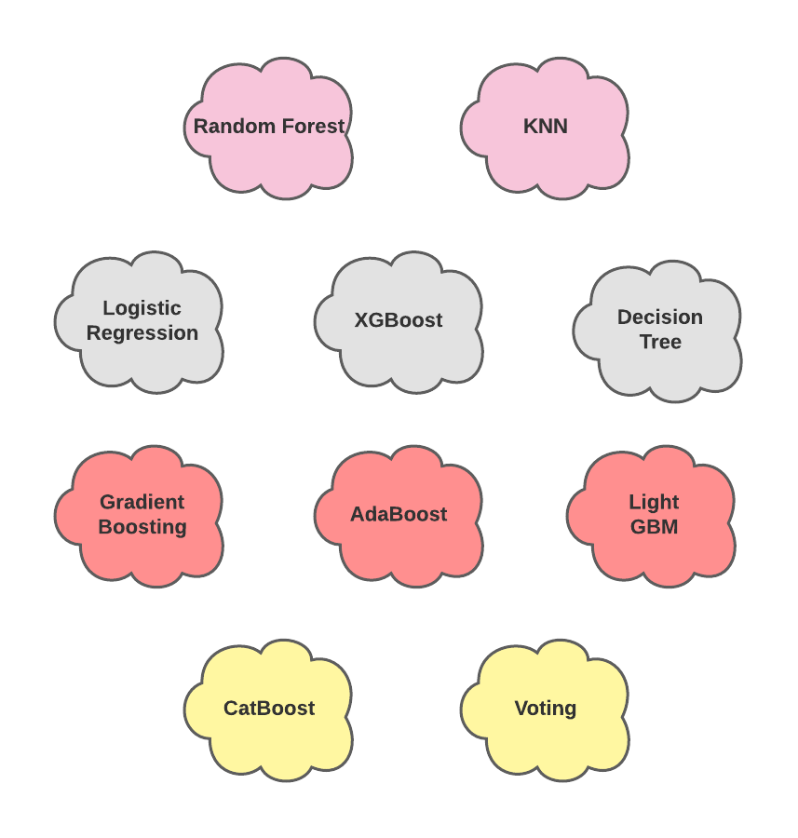
Modeling and Data fitting
Models Used

Slide 19
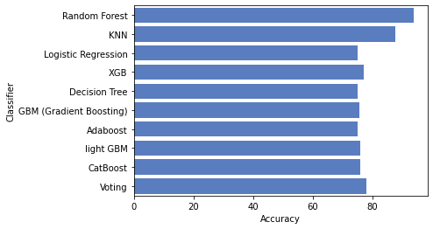
Comparison between Classifiers
After trying 10 classification models, we can see that the Random forest and the KNN algorithms are the best Classifiers for this data

Slide 20
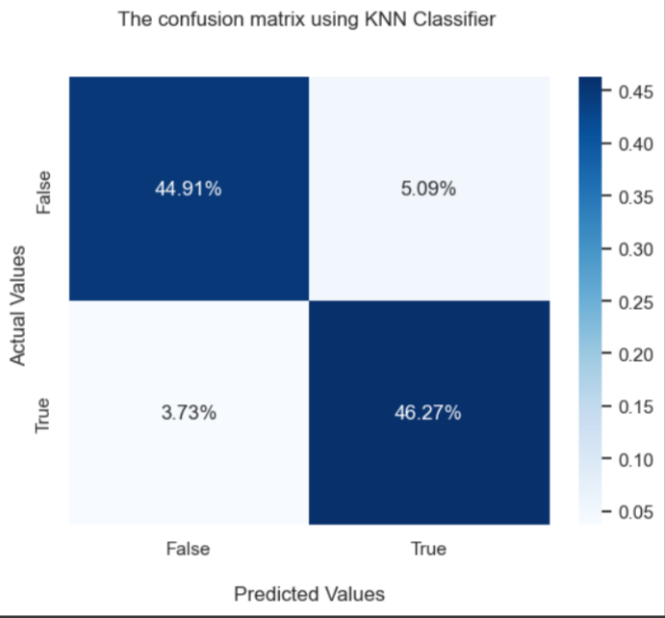
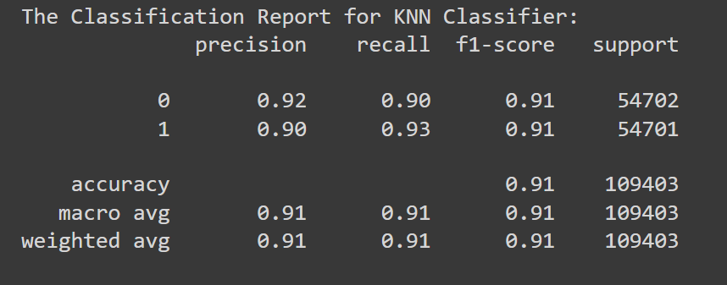
KNN

Slide 21
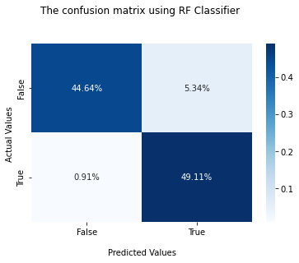
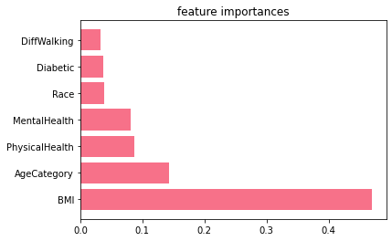
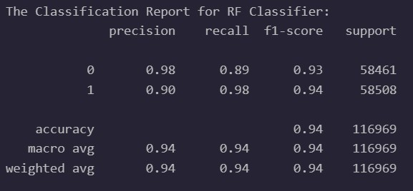
Random Forest

Slide 22


Prevention is better than cure
1. If you are afraid of getting a heart attack, you should stop smoking and Do some exercise.

Slide 23

Prevention is better than cure
2. Taking enough hours for sleep on average 7 hrs. per day will help you keep your heart healthy and your brain fresh.

Slide 24

Prevention is better than cure
3. Keeping your body healthy and fit will prevent you from getting Diabetes and Heart attacks.

Slide 25


Slide 26


